Slide 1
Reimaginando las carreras de ingeniería
Kevin Huggins, PhD

Slide 2
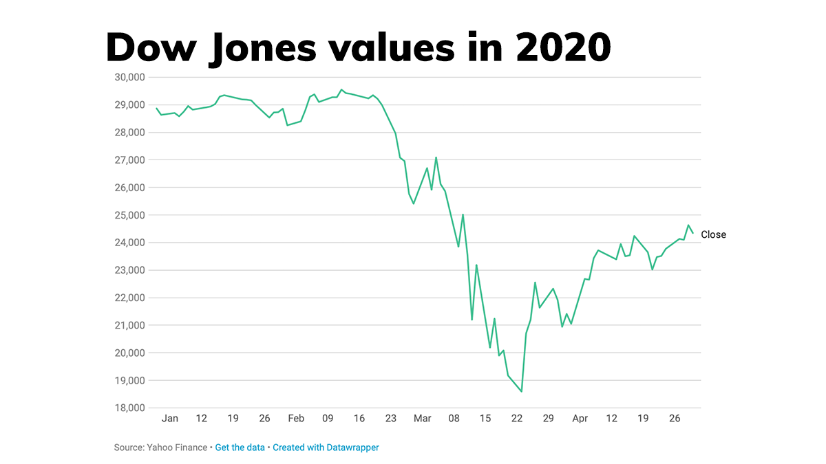
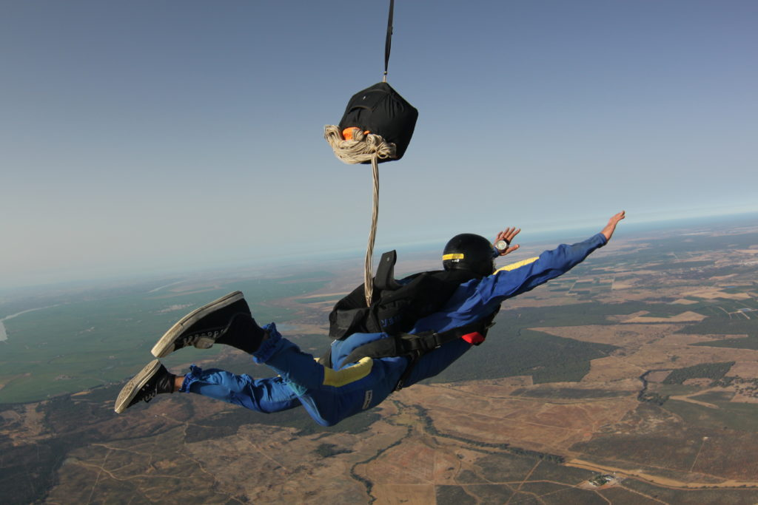


Academic leadership in a VUCA world: What is it and how can you thrive?
Volatility
Things are changing fast
Uncertainty
So what happens next?
Complexity
Many pieces to consider
Ambiguity
The situation is unclear,
and so is the solution
Notes:
https://www.marketplace.org/2020/05/01/how-the-markets-are-reacting-to-covid-19/
https://www.flynfriends.com/shop/skydiving/aff-course/#.XyAsB-cpDb0
https://www.clickorlando.com/features/2020/04/20/these-websites-will-let-you-do-a-puzzle-with-your-friends/
https://medium.com/@nstjohn10/turning-ambiguity-into-action-a-framework-52043fbedd6a
Volatility
We live in a world that’s constantly changing, becoming more unstable each day, where changes big and small are becoming more unpredictable – and they’re getting more and more dramatic and happening faster and faster. As events unfold in completely unexpected ways, it’s becoming impossible to determine cause and effect.
Uncertainty
It’s becoming more difficult to anticipate events or predict how they’ll unfold; historical forecasts and past experiences are losing their relevance and are rarely applicable as a basis for predicting the shape of things to come. It’s becoming nearly impossible to plan for investment, development, and growth as it becomes increasingly uncertain where the route is heading.
Complexity
Our modern world is more complex than ever. What are the reasons? What are the effects? – Problems and their repercussions are more multi-layered, harder to understand. The different layers intermingle, making it impossible to get an overview of how things are related. Decisions are reduced to a tangled mesh of reaction and counter-reaction – and choosing the single correct path is almost impossible.
Ambiguity
“One size fits all” and “best practice” have been relegated to yesterday – in today’s world it’s rare for things to be completely clear or precisely determinable. Not everything is black and white – grey is also an option. The demands on modern organizations and management are more contradictory and paradoxical than ever, challenging our personal value systems to the core. In a world where the “what” takes a back seat to the “why?” and the “how?”, making decisions requires courage, awareness, and a willingness to make mistakes.

Slide 3
VUCA: A solution option
Volatility
Uncertainty
Complexity
Ambiguity
Notes:
Vision
Paint a picture of the future you want. Together, as a compass and for orientation; in order to confer meaning and spark motivation – and to forge internal and external identity and effectiveness.
Understanding
Understand interconnections; make them transparent. Reflect on the context. Think and plan meta-strategically. Start from the result and work backwards. Harmonize skills. Embrace and exploit behaviors and reactions. Convert anxiety and resistance into productive energy.
Clarity
Simplicity. Focus on what counts and what it's really about. Trust, transparent connections, and processes. Apply energy and force exactly where they will be most effective.
Adaptability/Agility
Flexibility. Agility. Scrutinize hierarchical management techniques. Promote a consistent culture for making decisions and accounting for mistakes. Interact transparently with objections. Facilitate innovation and build up resilience.

Slide 4
VUCA: A solution option
Volatility
Uncertainty
Complexity
Ambiguity
Vision
  Paint a picture of your desired future
Notes:
Vision
Paint a picture of the future you want. Together, as a compass and for orientation; in order to confer meaning and spark motivation – and to forge internal and external identity and effectiveness.

Slide 5
VUCA: A solution option
Volatility
Uncertainty
Complexity
Ambiguity
Vision
Understanding
  Consider the context and interconnections
.
Notes:
.
Understanding
Understand interconnections; make them transparent. Reflect on the context. Think and plan meta-strategically. Start from the result and work backwards. Harmonize skills. Embrace and exploit behaviors and reactions. Convert anxiety and resistance into productive energy.

Slide 6
VUCA: A solution option
Volatility
Uncertainty
Complexity
Ambiguity
Vision
Understanding
Clarity
  Keep it simple and focused
Notes:
Clarity
Simplicity. Focus on what counts and what it's really about. Trust, transparent connections, and processes. Apply energy and force exactly where they will be most effective.

Slide 7
VUCA: A solution option
Volatility
Uncertainty
Complexity
Ambiguity
Vision
Understanding
Clarity
Adaptability/Agility
  Stay flexible and agile
Notes:
Adaptability/Agility
Flexibility. Agility. Scrutinize hierarchical management techniques. Promote a consistent culture for making decisions and accounting for mistakes. Interact transparently with objections. Facilitate innovation and build up resilience.

Slide 8
VUCA: A solution option
Volatility
Uncertainty
Complexity
Ambiguity
Vision
Understanding
Clarity
Adaptability/Agility
Notes:
Vision
Paint a picture of the future you want. Together, as a compass and for orientation; in order to confer meaning and spark motivation – and to forge internal and external identity and effectiveness.
Understanding
Understand interconnections; make them transparent. Reflect on the context. Think and plan meta-strategically. Start from the result and work backwards. Harmonize skills. Embrace and exploit behaviors and reactions. Convert anxiety and resistance into productive energy.
Clarity
Simplicity. Focus on what counts and what it's really about. Trust, transparent connections, and processes. Apply energy and force exactly where they will be most effective.
Adaptability/Agility
Flexibility. Agility. Scrutinize hierarchical management techniques. Promote a consistent culture for making decisions and accounting for mistakes. Interact transparently with objections. Facilitate innovation and build up resilience.

Slide 9
OODA loop
Observe
What is the current situation?
Act
Observe
Orient
Where are you currently relative to where you want to go?
Decide
Orient
Decide
What is the exact path you are going to take?
Act
What are you going to do?
Notes:
https://online.visual-paradigm.com/diagrams/templates/ooda-loop/ooda-loop-template/
Air Forcer Colonel John Boyd. He applied this concept to the combat operations process.
Observe:
The first step is to identify the problem or threat and gain an overall understanding of the internal and external environment. In the corporate world, this can be equated to data gathering, where all of the information regarding the current organizational state, any competitors and the market is collected. The key point about the observe step is recognizing that the world is complex. All data is a snapshot in time and must be treated as such. Therefore, entities must gather whatever information is available as quickly as possible in order to be prepared to make decisions based on it.
Orient:
The orientation phase involves reflecting on what has been found during observations and considering what should be done next. It requires a significant level of situational awareness and understanding in order to make a conscious decision. Since some decisions are unconscious, or instinctual, this step involves considering what and why decisions are made prior to choosing a course of action. When applied on an individual level, the orientation step can be done by creating mental models or mental rehearsal drills to place information into narratives that shape judgement. In organizational applications, situational models can be created with machine learning (ML) tools to identify potential outcomes while removing any bias.
Decide:
The decision phase makes suggestions towards an action or response plan, taking into consideration all of the potential outcomes. This can be accomplished through meetings or discussions that are focused around creating a roadmap for the entire organization.
Act:
Action pertains to carrying out the decision and related changes that need to be made in response to the decision. This step may also include any testing that is required before officially carrying out an action, such as compatibility or A/B testing.

Slide 10
Academic leadership in a VUCA world: What is it and how can you thrive?
Make sure your OODA loop is as tight as possible
Act
Observe
Decide
Orient
Notes:
Asegúrese de que su bucle OODA sea lo más pequeño posible

Slide 11
Needs to be people focused
Organizational culture shift
Different perspective on sharing knowledge.

Slide 12
¿Qué elementos considera fundamentales para transformar las carreras de ingeniería?
  Agility
    Curriculum updates
      Constant connection with constituents
      Empowered professors
  Respect for diversity in learners
    Bill and Linda Gates foundation
¿Cuál debe ser el papel de la decana/decano para lograr esa transformación?
Desde su experiencia, ¿considera que acciones concretas sugiere para adelantar iniciativas que inviten a reimaginar una carrera de ingeniería?

